Slide 1
Civil and Political Rights
Eyal Bar, Ph.D.
Arizona State University Spring 2017
POS368 – Ethics and Human Rights

Slide 2
ICCPR
Signed December 16, 1966 alongside International Covenant on Economic Social and Cultural Rights (ICESCR)
Entered into force March 23, 1976 after 35th ratification.
Together with ICESCR, UN Declaration of Human Right (UNDHR) considered part of the “International Bill of Rights”
Secures the equal rights of all persons, mostly negative liberty (freedom from coercion, torture, discrimination, freedom of conscience, movement, etc).

Slide 3
How are rights defended?
Through UN States bringing complaint through General Assembly, Security Council, International Criminal Court, and International Court of Justice
Through Individuals bringing complaints to the relevant body in charge of overseeing a particular treaty (A Covenant or a Convention).
Can only bring complaint against states that are party to the treaty.
And who recognize the competence of the relevant oversight committee (whose members are selected by member states).
By signing Optional Protocol
By making declaration of competence as outlined in the given covenant/treaty (Article 41)

Slide 4
Is it sufficient?
“The individual complaints procedure has been criticized because it lacks a follow-up procedure by which the committee’s views are translated into a binding decision. Instead, under the Protocol, the case is effectively closed once the committee’s communications are forwarded to the parties. The only pressure on the state party to comply with the committee’s views must come from the moral authority of the committee and the publicity generated by the process, and to date, the committee has not been able to generate much public interest or awareness” (Keith, 99)

Slide 5
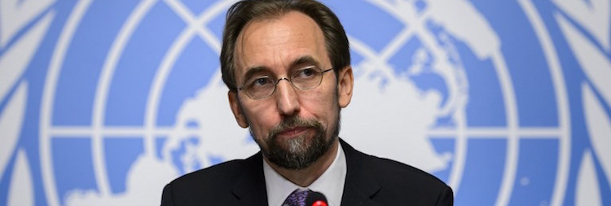
How are rights defended?
By States issuing annual reports to the relevant UN Committees in charge of overseeing a Convention or Covenant (e.g., UN Human Rights Council that oversees the implementation of ICCPR).
That is to say, States self-report their human rights conditions to the UN.
By publicity (“Naming and Shaming”)
More on that later in the semester.
Through bi-lateral treaties (e.g., preferential trade agreements).
Through multi- or unilateral action.
Libya intervention
Former Yugoslavia interventions

Slide 6
Problems with ICCPR
States need to self-report, bringing into question the objectivity of the reports
States often file reports late
Committee cannot compel states to take action
Sometimes individuals can’t get their claims to the committee (no independent oversight mechanisms)
Keith claims regimes that are most likely to abuse human rights are most likely not to sign onto the covenant.
Not necessarily
Temporary derogations in time of emergency (there is an Article allowing for this) result in increased violation of personal integrity.
Politically motivated?

Slide 7
Why accession to treaty might not alter behavior
Implementation mechanism too weak
State may join to deflect criticism without intention or ability to change behaviour
State could be coerced to join without intention or ability to change behavior
Internal factors (civil war, economic constraints) could harm human rights even if state signs on

Slide 8
Other factors that might affect human rights
Political democracy
Population Size
Resource constraints
Increase probabilities/opportunities
Economic development
Civil War
International War
British Cultural Influence/Colonialism?
Military Regime
Leftist Party?
Are State Department and Amnesty International reliable sources?

